Slide 1
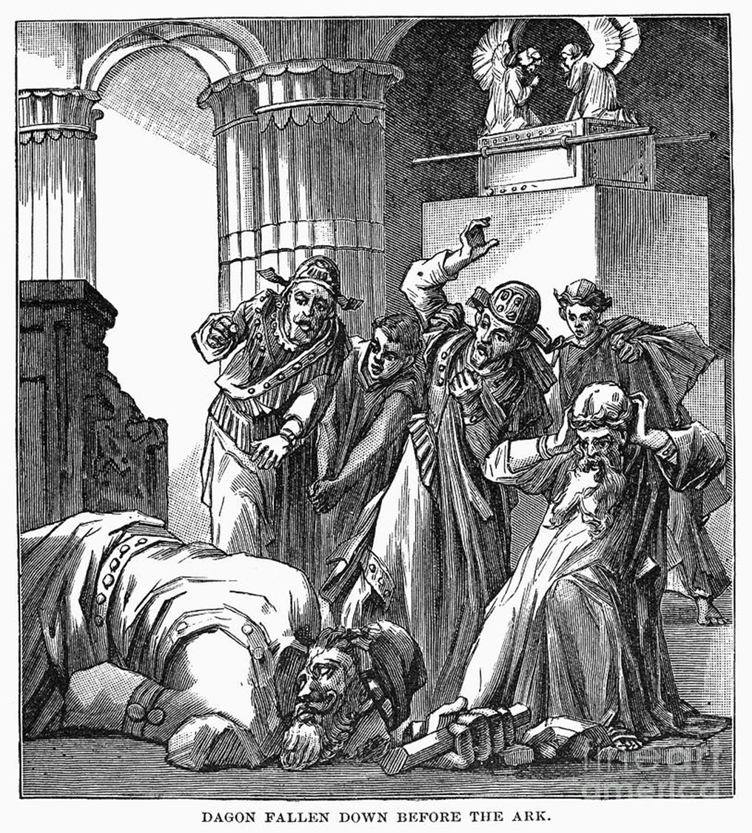
THERE IS
NO GOD
LIKE OUR GOD!
1 SAMUEL 5

Slide 2
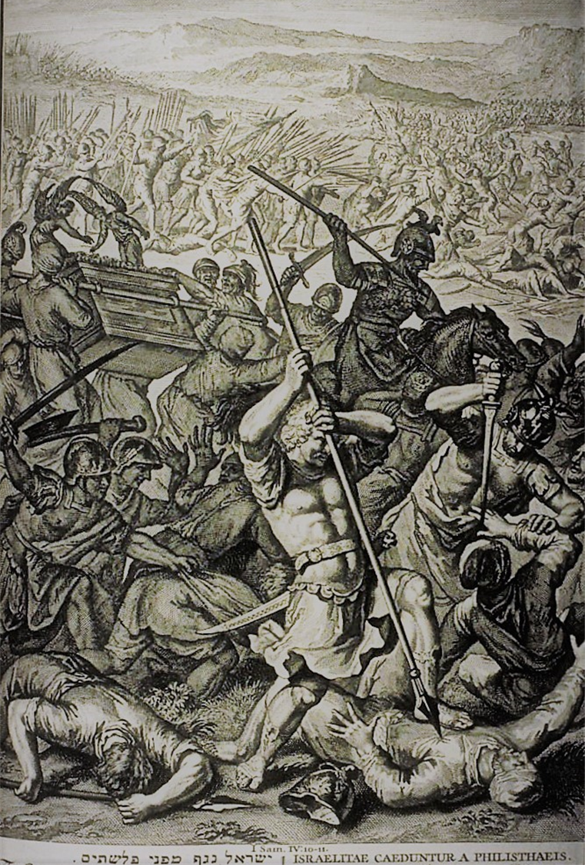
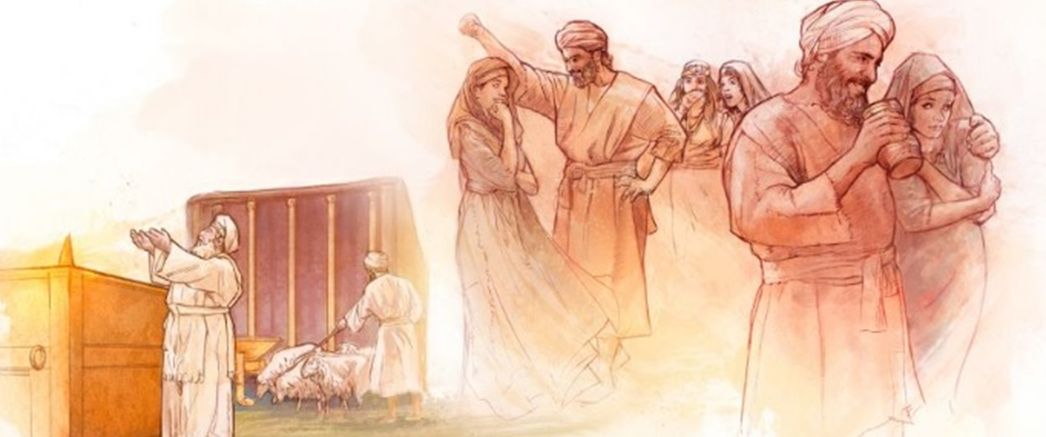
The danger of presumption.
Israel was defeated
The ark of God was taken
The wicked priests were slain
Eli died
The Philistines (the lost) get full of themselves

Slide 3
THERE IS
NO GOD
LIKE OUR GOD!
1 SAMUEL 5

Slide 4
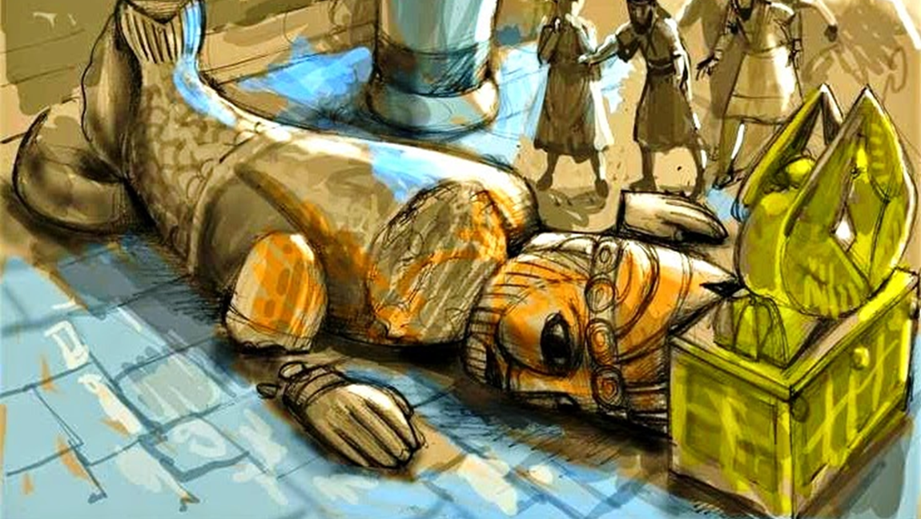
The danger of presumption.
Presumption against God brings a curse that hinders every aspect of life.
Notice how God’s glory is defended against the pagan.

Slide 5
2 Samuel 6:6-7 And when they came to Nachon's threshingfloor, Uzzah put forth his hand to the ark of God, and took hold of it; for the oxen shook it. 7 And the anger of the LORD was kindled against Uzzah; and God smote him there for his error; and there he died by the ark of God.

Slide 6
Luke 12:48 48 But he that knew not, and did commit things worthy of stripes, shall be beaten with few stripes. For unto whomsoever much is given, of him shall be much required: and to whom men have committed much, of him they will ask the more.

Slide 7
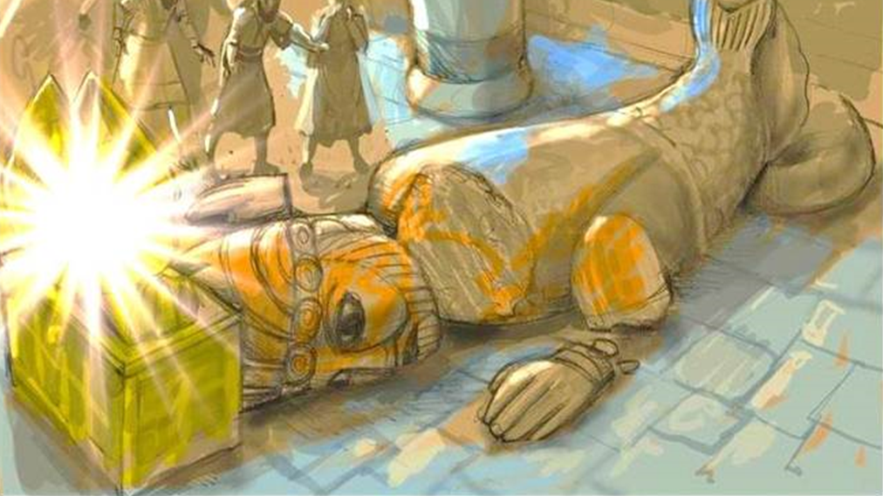
Problem 1: They presumed to “add” God to their gods.

Slide 8
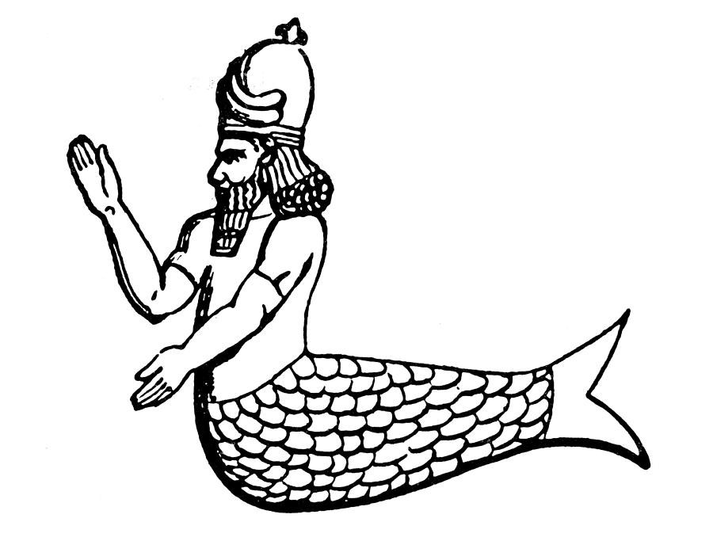

Slide 9
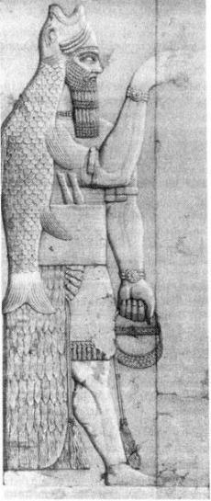
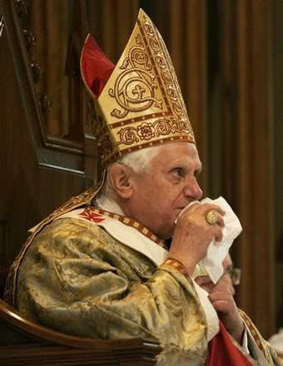

Slide 10
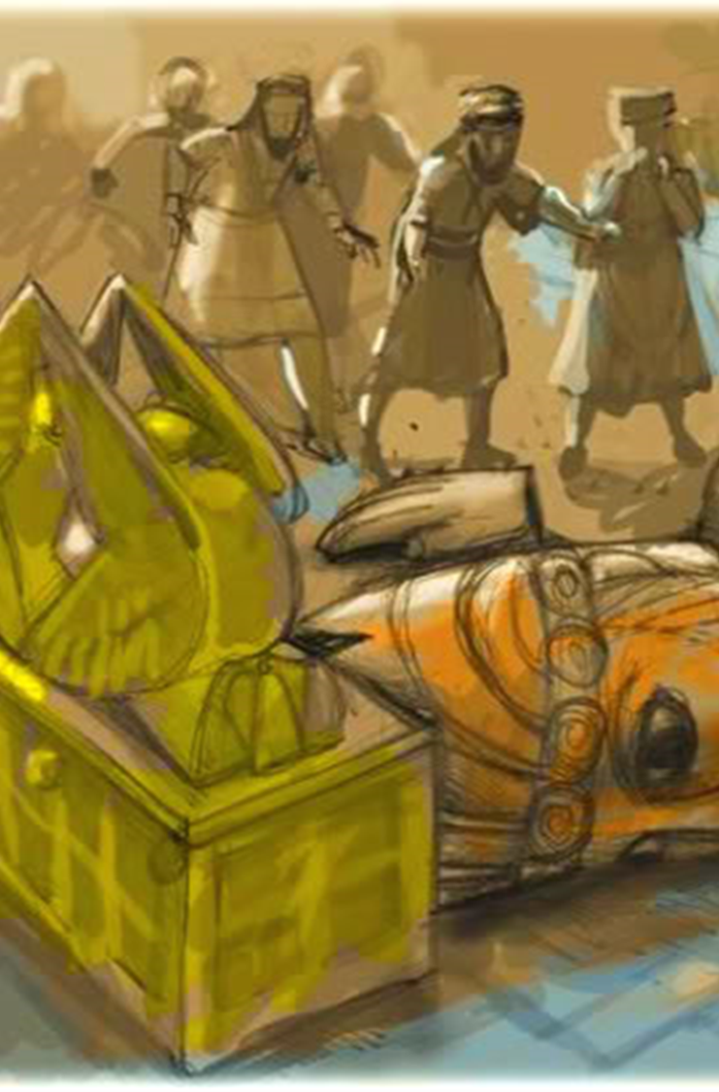
Problem 2: The Philistines felt right only because God’s people did wrong!
When God’s people live presumptuously against God, it gives the enemies of God a way to boast.
Can you really capture God?

Slide 11
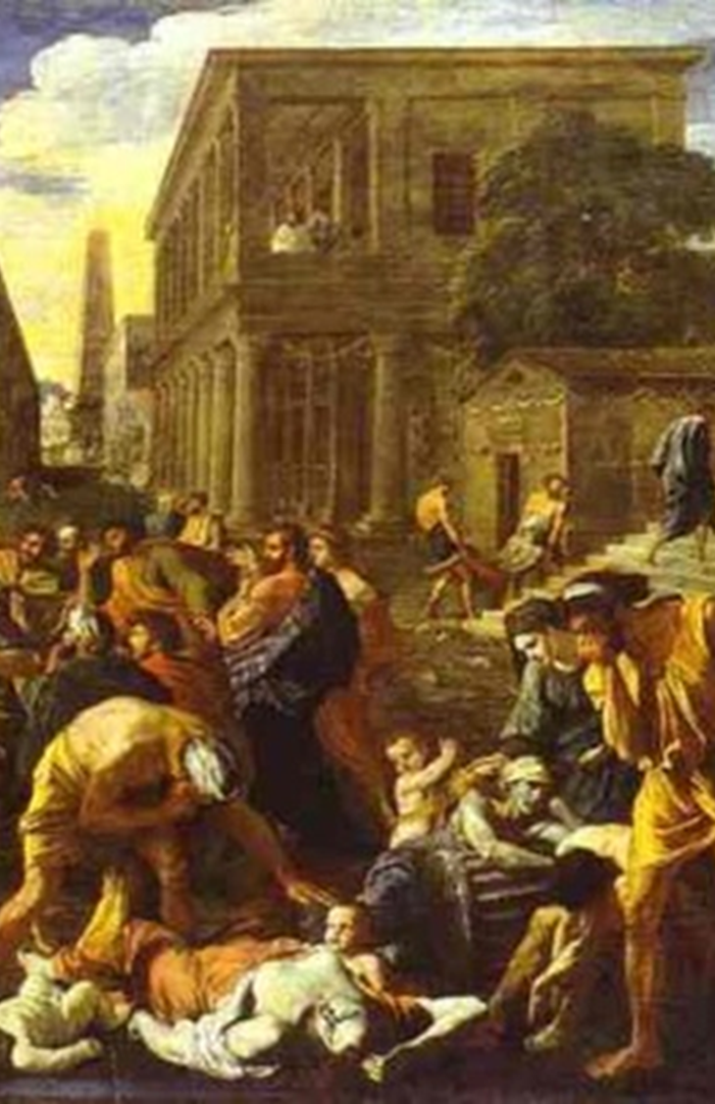
Problem 3: Presumption against God brings suffering, not triumph!
The Ark contained the Law of God, the Rod of Aaron and the manna.
God’s wrath over their sin is seen here in chapter 5. (Law and Rod.)
God brought them to famine in chapter 6. (Manna - Mice overran the land and marred it! 6:5)

Slide 12
Philippians 2:9-11 Wherefore God also hath highly exalted him, and given him a name which is above every name: 10 That at the name of Jesus every knee should bow, of things in heaven, and things in earth, and things under the earth; 11 And that every tongue should confess that Jesus Christ is Lord, to the glory of God the Father.

Slide 13
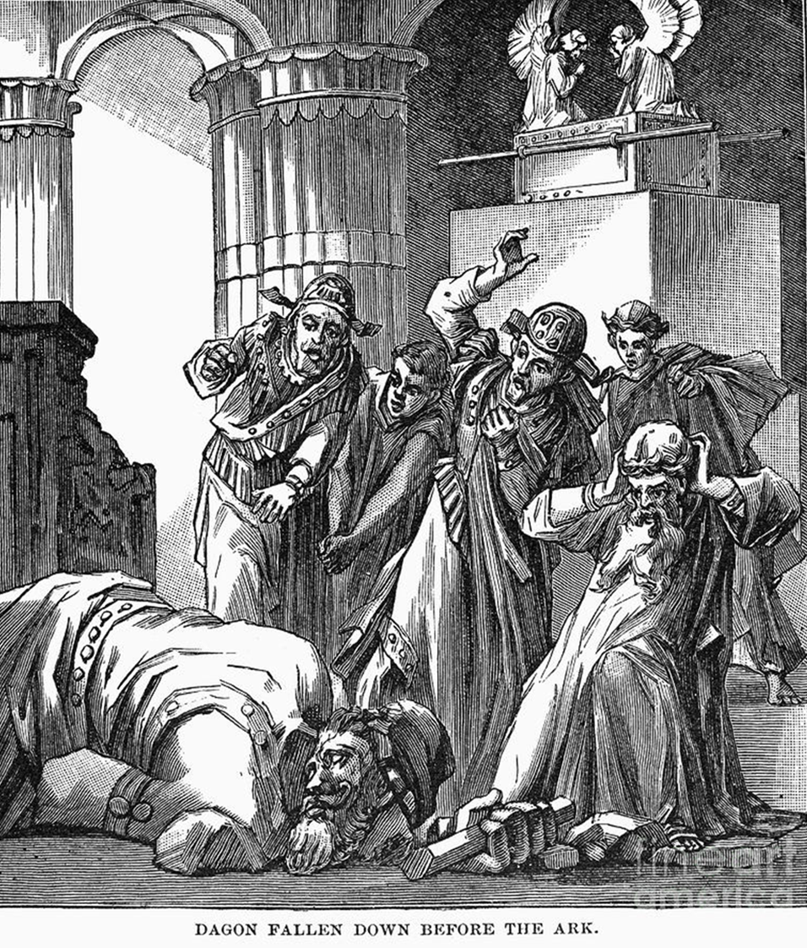
Problem 4:
They refused correction.

Slide 14
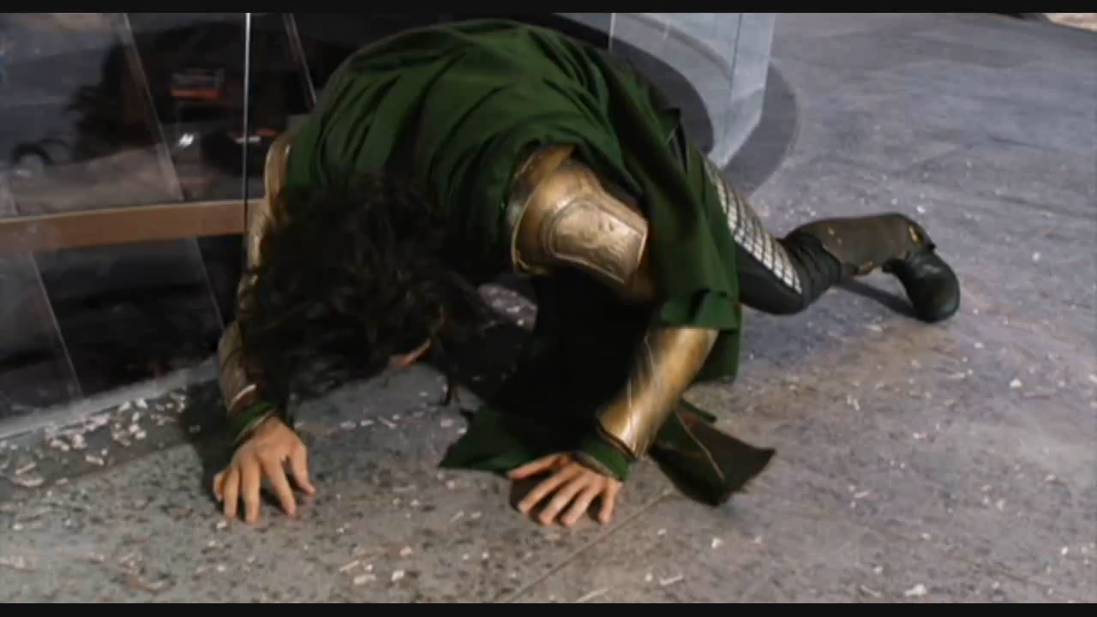

Slide 15
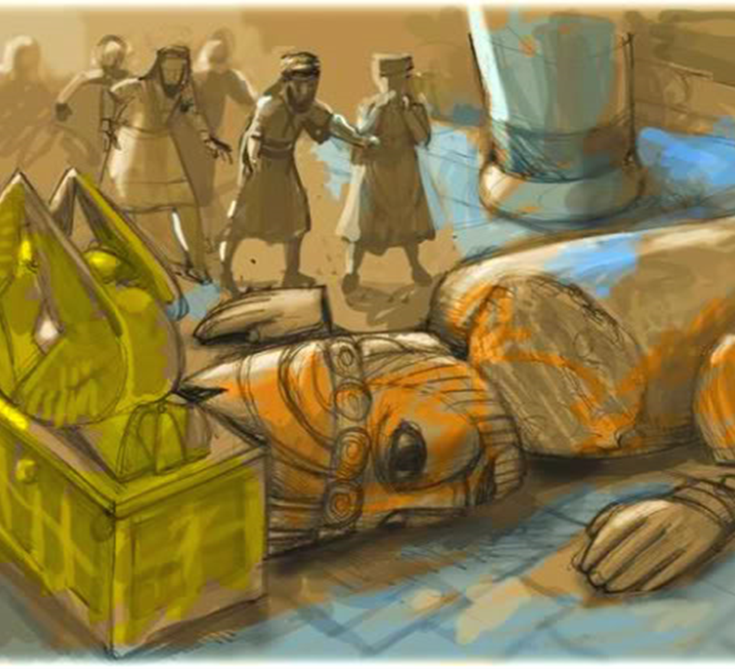
The battle!
Eph 6:10-12
Head = authority. Cut off!
Genesis 3:15
Palms = ability to take, to work.
Cut off!

Slide 16
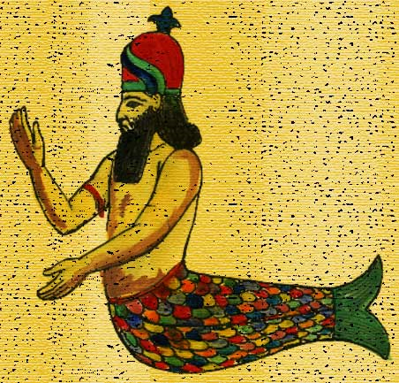

Slide 17
Daniel 2:42-44 And as the toes of the feet were part of iron, and part of clay, so the kingdom shall be partly strong, and partly broken. 43 And whereas thou sawest iron mixed with miry clay, they shall mingle themselves with the seed of men: but they shall not cleave one to another, even as iron is not mixed with clay. 44 And in the days of these kings shall the God of heaven set up a kingdom, which shall never be destroyed: and the kingdom shall not be left to other people, but it shall break in pieces and consume all these kingdoms, and it shall stand for ever.

Slide 18
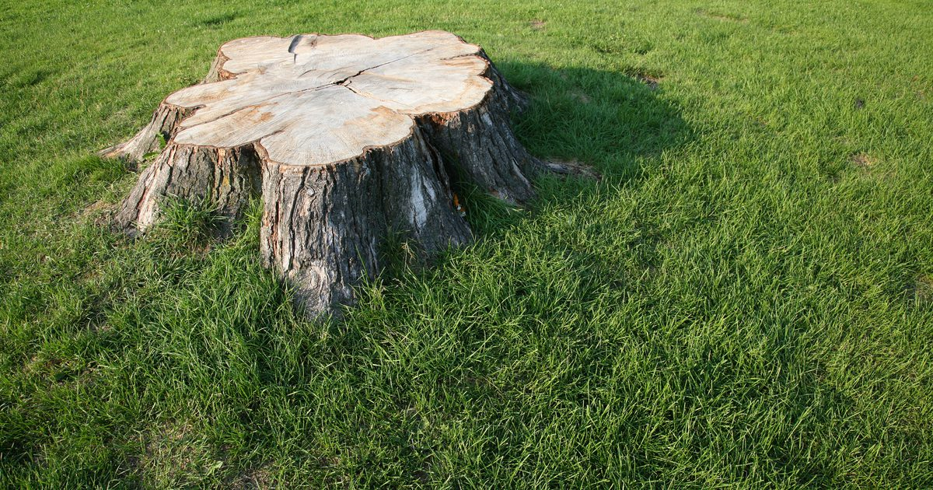

Slide 19
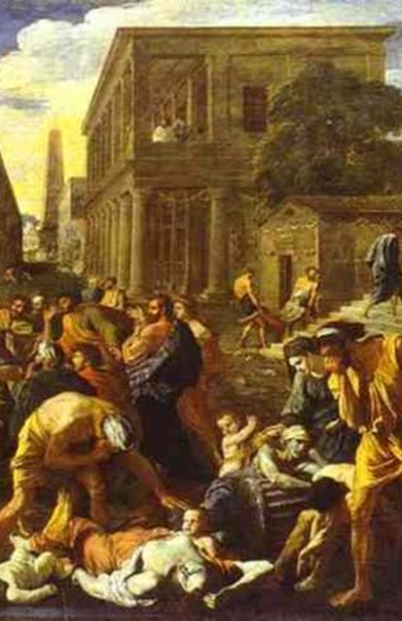
The death and pain of disrespect..
Ashdod = “ravager”
Gath = “a winepress”

Slide 20
Isaiah 63:1-6 Who is this that cometh from Edom, with dyed garments from Bozrah? this that is glorious in his apparel, travelling in the greatness of his strength? I that speak in righteousness, mighty to save. 2 Wherefore art thou red in thine apparel, and thy garments like him that treadeth in the winefat? 3 I have trodden the winepress alone; and of the people there was none with me: for I will tread them in mine anger, and trample them in my fury; and their blood shall be sprinkled upon my garments, and I will stain all my raiment.

Slide 21
4 For the day of vengeance is in mine heart, and the year of my redeemed is come. 5 And I looked, and there was none to help; and I wondered that there was none to uphold: therefore mine own arm brought salvation unto me; and my fury, it upheld me. 6 And I will tread down the people in mine anger, and make them drunk in my fury, and I will bring down their strength to the earth.

Slide 22
The death and pain of disrespect..
Ashdod = “ravager”
Gath = “a winepress”
Ekron = “to pluck up” by the roots! To hamstring, meaning to exterminate!
Emerod = from an unused root meaning to burn.
God has a way of getting our attention.
When God is working with us, to many will work to get around God.

Slide 23
1 Peter 5:5-7 Likewise, ye younger, submit yourselves unto the elder. Yea, all of you be subject one to another, and be clothed with humility: for God resisteth the proud, and giveth grace to the humble. 6 Humble yourselves therefore under the mighty hand of God, that he may exalt you in due time: 7 Casting all your care upon him; for he careth for you.

Slide 24
THERE IS
NO GOD
LIKE OUR GOD!
1 SAMUEL 5

